Slide 1

Olympic Data Analysis
A machine learning approach to extracting meaningful insights from Olympic Games data.
RADHIKA
322101027

Slide 2

Introduction
Objective: Analyzing Olympic Games data using advanced machine learning techniques.
Historical Datasets
Modern Data Sources
Athlete performances, medal counts, and socio-economic indicators.
Social media analytics, athlete training logs, and real-time performance data.

Slide 3

Purpose of the Project
To gain a deeper understanding of Olympic trends and factors influencing performance.
1
Performance Trends
2
Medal Distribution
Analyzing how performance has evolved over time.
Investigating the distribution of medals across different countries and events.
3
Socio-Economic Impact
4
Predictive Modeling
Evaluating the role of socio-economic factors in Olympic success.
Developing models to predict future Olympic outcomes.

Slide 4
Technologies and Tools
Utilizing a range of technologies and tools for data analysis and visualization.
Data Manipulation
Scientific Computing
Visualization
Pandas, Matplotlib
NumPy & SciPy
Seaborn & Plotly

Slide 5
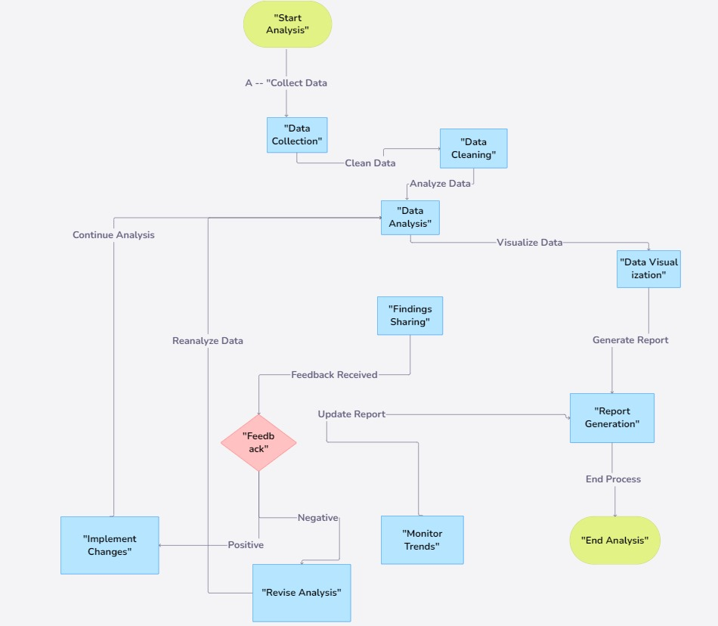
Data Collection & Preprocessing
Collecting and preparing the data for analysis.
1
Data Sources
Olympic history dataset from Kaggle .
2
Data Cleaning
Handling missing data, inconsistencies, and outliers.
3
Data Integration
Merging relevant datasets to create a comprehensive analysis set.

Slide 6
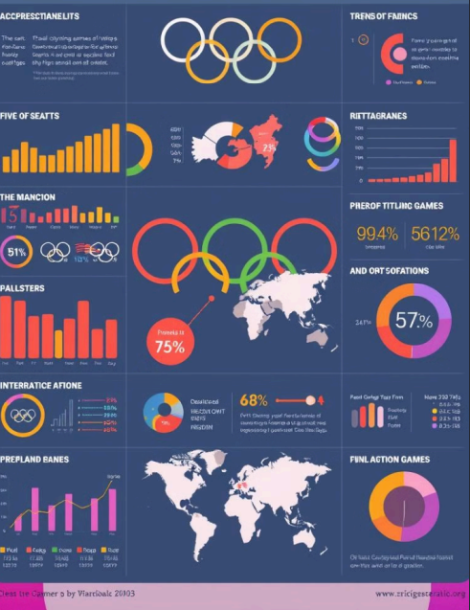
Exploratory Data Analysis (EDA)
Exploring the data to identify key trends and insights.
1
Participation Trends
2
Medal Distribution
Increase in the number of participating athletes and nations.
Analyzing the distribution of medals by country and event.
3
Performance Metrics
Investigating age, gender, and country-wise performance trends.

Slide 7
Machine Learning Models
Developing machine learning models to predict outcomes and analyze patterns.
Predictive Models
Clustering Models
Logistic regression, decision trees, and neural networks for medal predictions.
Clustering countries and athletes based on performance patterns.

Slide 8

Challenges in Data Analysis
Analyzing Olympic data presents several unique challenges due to the complexity and scale of the event. Here are some key challenges in Olympic data analysis:
1
Data Quality, Accuracy, Consistency
Ensuring the accuracy of historical datasets is crucial for reliable analysis.
2
Complexity, Volume, Integration
Managing large volumes of data from various sources adds to the complexity of analysis.
3
Resource Allocation, Training, Tools
Insufficient resources and training can hinder effective data analysis.

Slide 9
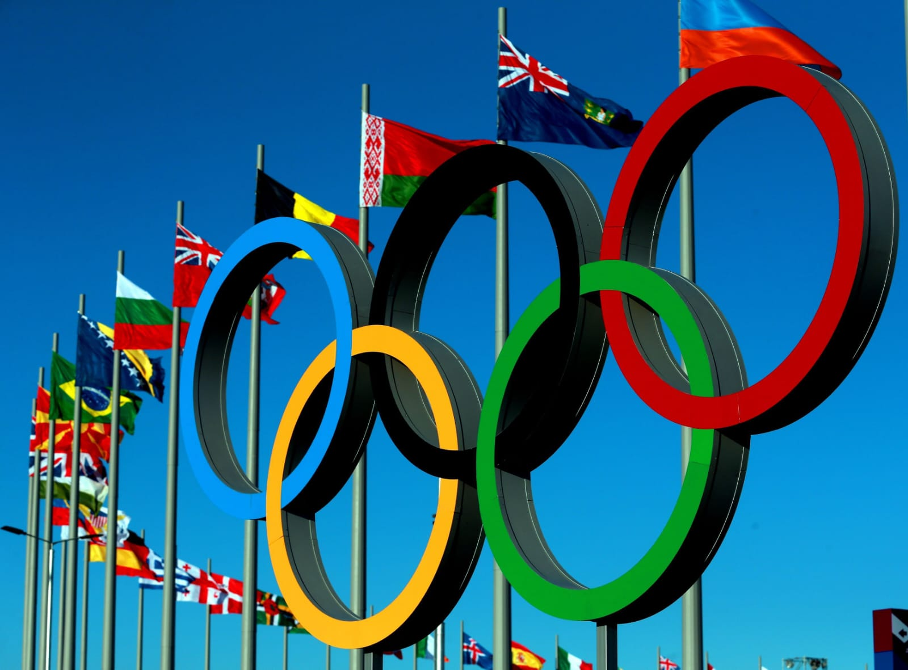
Results
Evaluating the performance of the developed models.
Model
Accuracy
Key Predictors
Medal Prediction
85-90%
Age, previous experience, event type.
Athlete Segmentation
75-80%
Training regimen, performance history, athlete demographics.

Slide 10
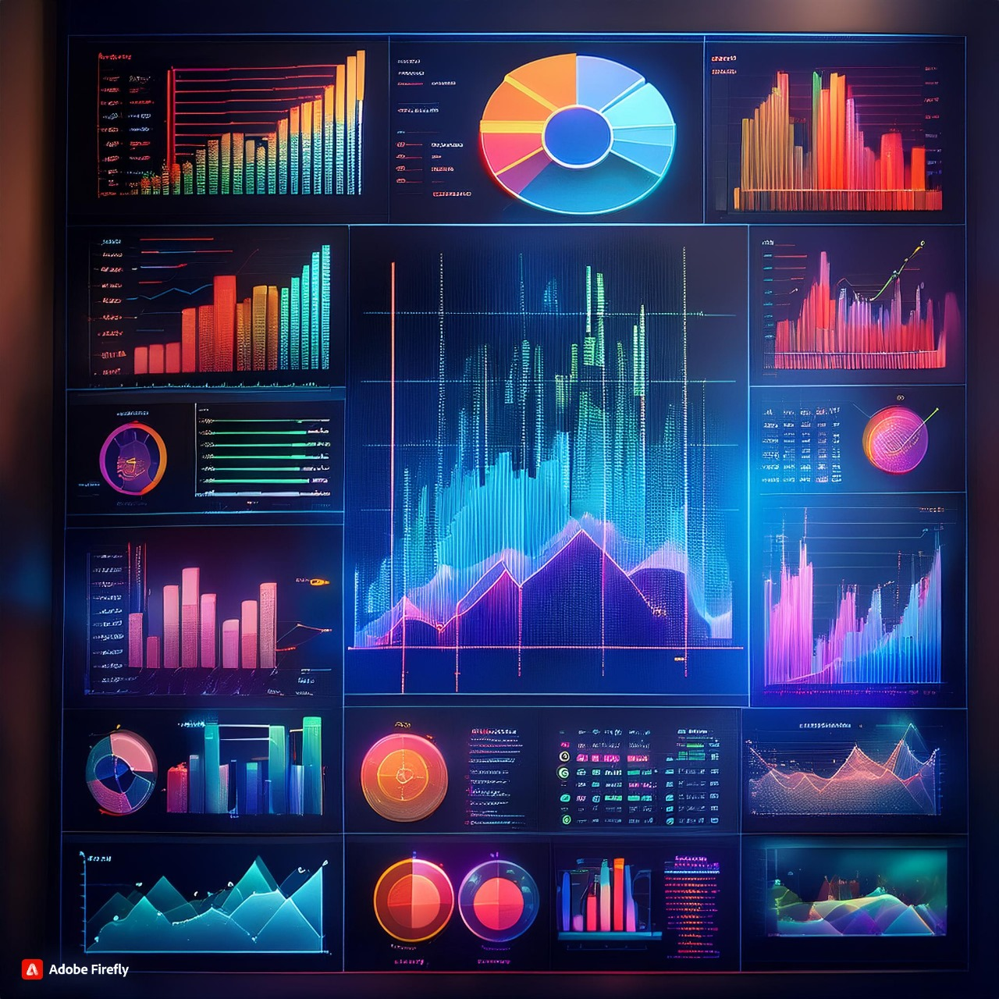



Visualization & Reporting
Creating interactive dashboards and reports to communicate findings.
Medal Tally
Visualizing medal counts over time and across different countries.
Country-Wise Performance
Analyzing the performance of different countries in various events.
Athlete Demographics
Exploring the demographics and performance trends of Olympic athletes.

Slide 11
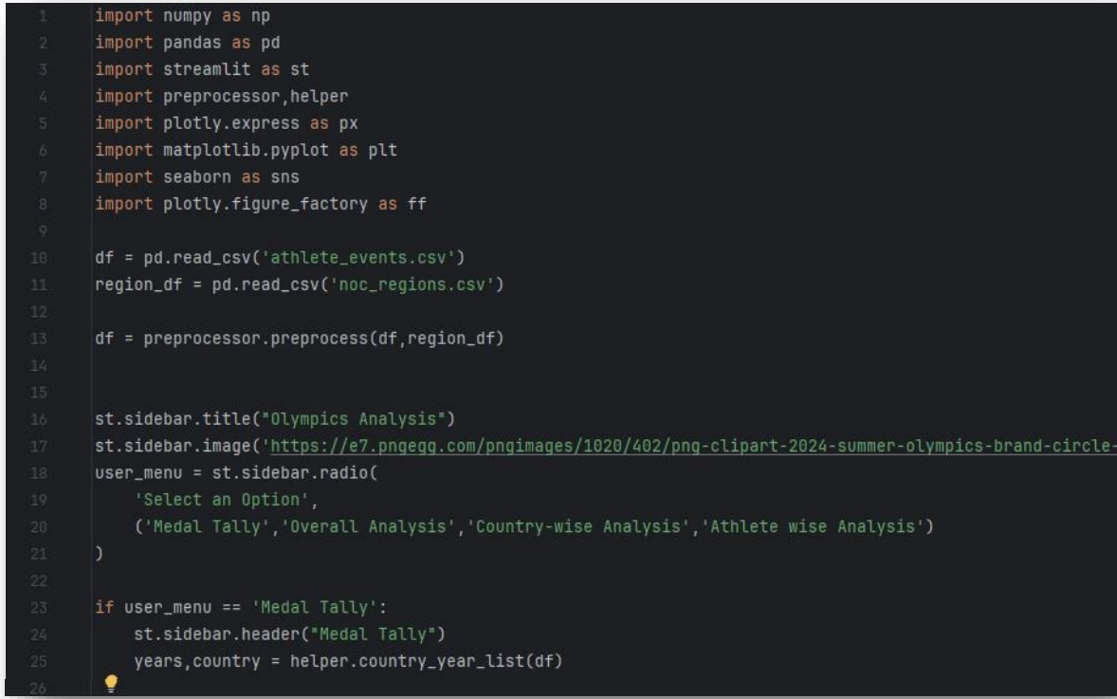
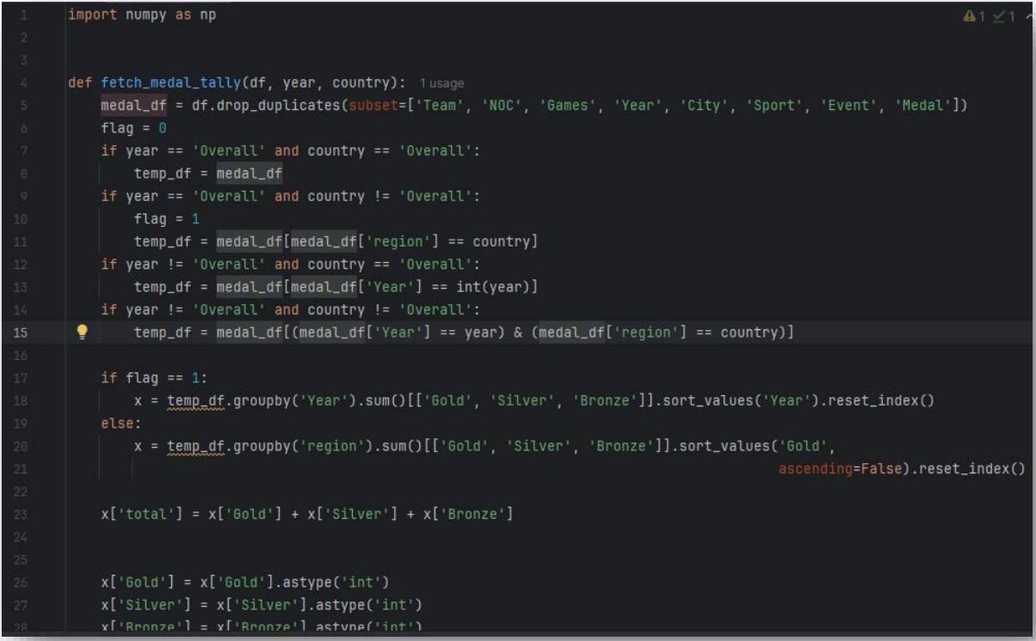
CODE SAMPLES :

Slide 12
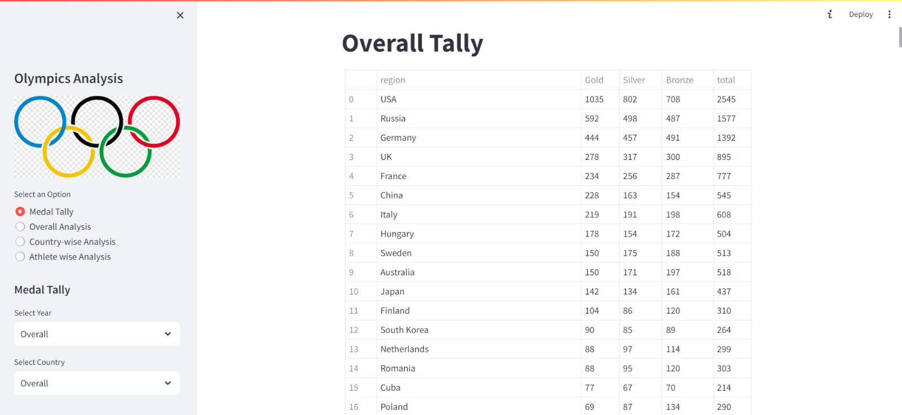
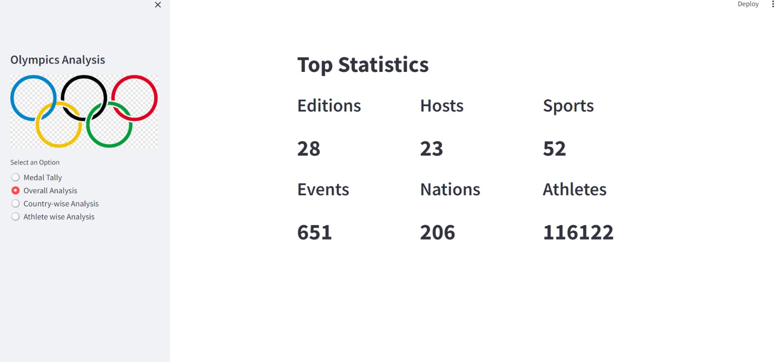
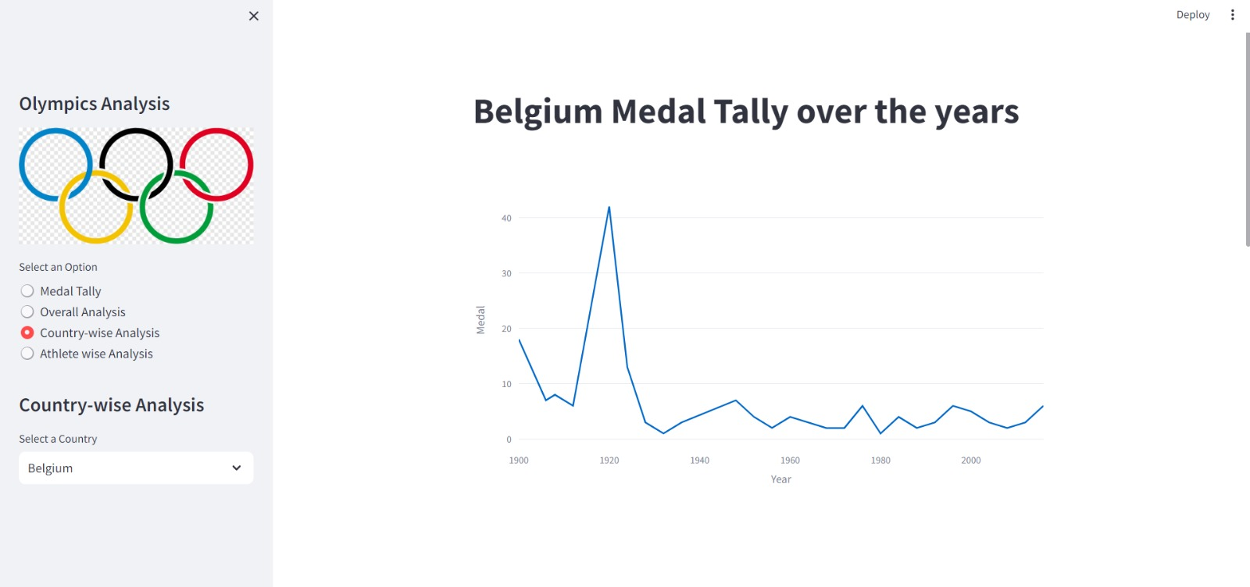
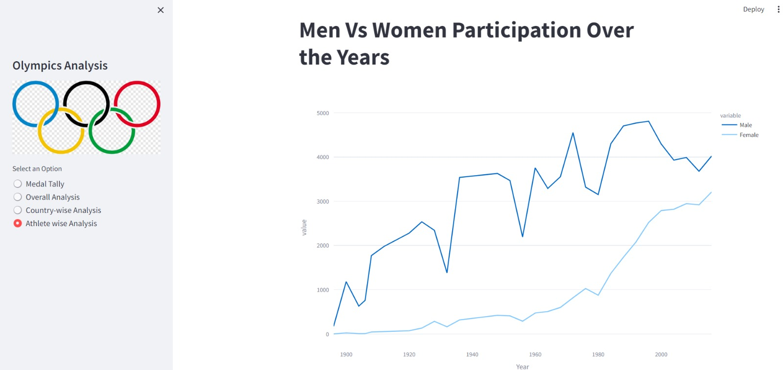
FINAL OUTCOMES :

Slide 13

Conclusion & Future Scope
Summarizing the key findings and outlining future research directions.
1
Conclusion
2
Future Scope
Machine learning models can effectively predict Olympic outcomes. Future studies should focus on integrating real-time data for immediate decision- making in competitions.
Real-time data integration , Implementing real-time analytics to enhance performance monitoring and strategic decision- making.

Slide 14
THANK YOU.

